Slide 1
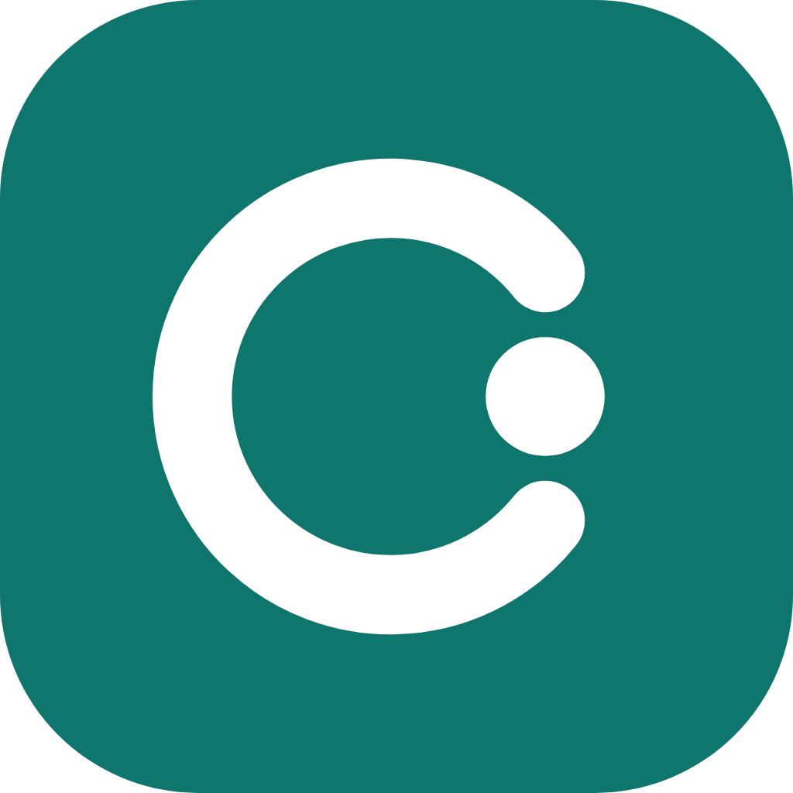
Concord
The app that unifies clinical trial systems source data
Sean Pun
Aleksander Kasperski
Timothy Wu
Dennis Chen

Slide 2
The challenge
Clinical trials generate data across separate software systems:
Inconsistent master data
Inflexible & slow reporting
Regulatory, compliance & access barriers
To extract insights, analysts spend WEEKS combining the sources and formatting them to a standard, which can still be prone to errors.

Slide 3
Our goal
To be able to ingest the unharmonized raw data from 5 clinical trial systems and output a user interface for analysts/engineers to query easily, adhering to FAIR principles
The same site has five names:
CTMS trial management - SITE-0708
EDC trial database - 708
IRT drug supply - US708
Safety - Seattle Center for Clinical Trials (sic)
Finance - SEATTLE CENTER FOR CLINICAL TRIALS, LLC

Slide 4
Introducing Concord:
the app to automate harmonization
Harmonizer
Server
Client
Ingests the data and standardizes to be joined into one query-able table
implements data rules to catch problems
home of the REST API for query endpoints
Translates user queries into SQL with Gemini
Implements different methods of user querying
User Interface
connects with server logic to allow users to query data
and
see lineage, crosswalk, quality, and access

Slide 5
Harmonization (Medallion Schema)
1
2
3
4
Ingestion of Data
Transform into Schema
Harmonize the IDs
Clean
Ingest the RAW data into DuckDB from 5 systems: CTMS, EDC, IRT, Financial, Safety
BRONZE
Transform the data so that IDs have a common format with regex.
Ex. ID is standardized to 4 digit
SILVER
Across all silver tables, JOIN by the master id based off the CTMS source data
MASTER
Remove duplicates and format properly. Runs quality checks. Final cleanup that the program can query.
GOLD

Slide 6
Standardization
Problems with transformation and the solutions
Problem:
Safety and Finance Systems do not have a numeric site ID
Solution:
Implement Jaccard set scoring by comparing site names and assigning a score based on how similar the site names were from the master site (CTMS)
Problem:
Incomplete dates (e.g. 2000-02)
Solution:
Implement a flagging system to warn against incomplete data

Slide 7
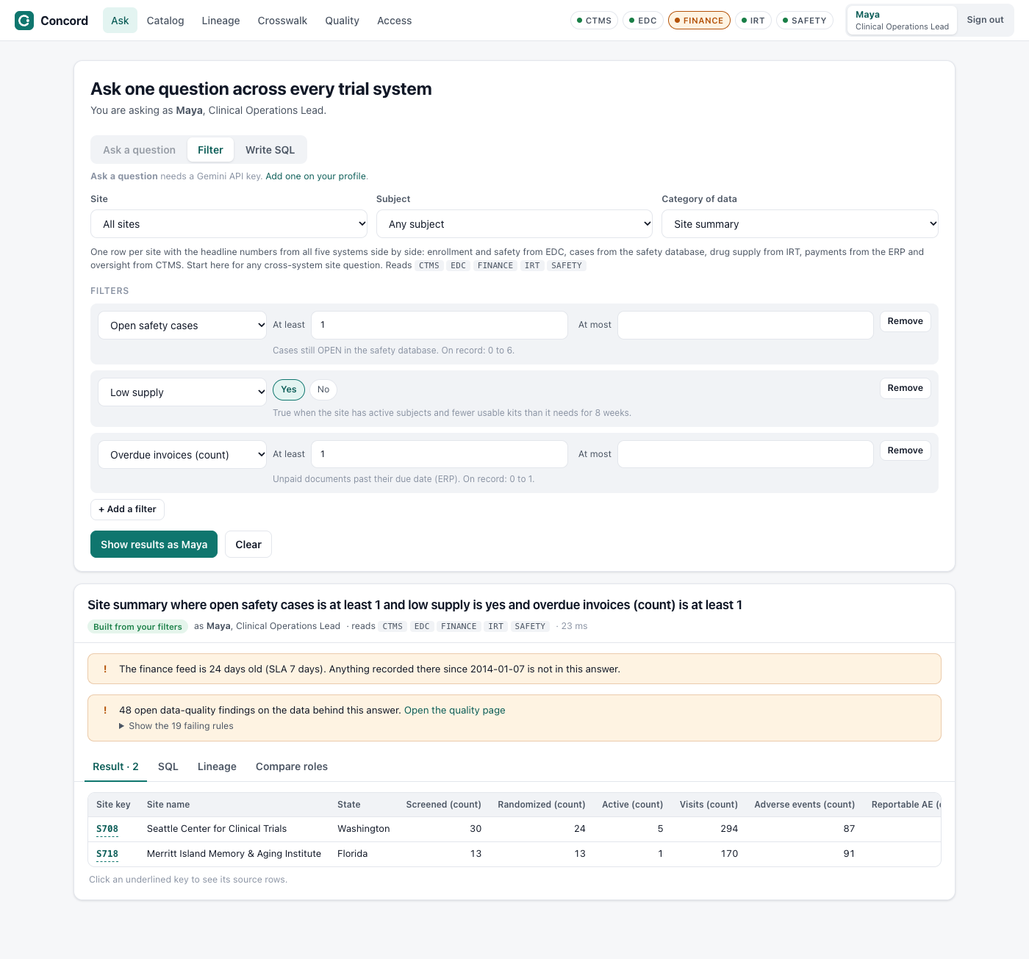
Server/Backend
Technologies: fastAPI, DuckDB, Python
Contains:
Connection to the Database
REST API (fastAPI) for query endpoints
General Logic for querying the database for lineage, crosswalk, and quality

Slide 8
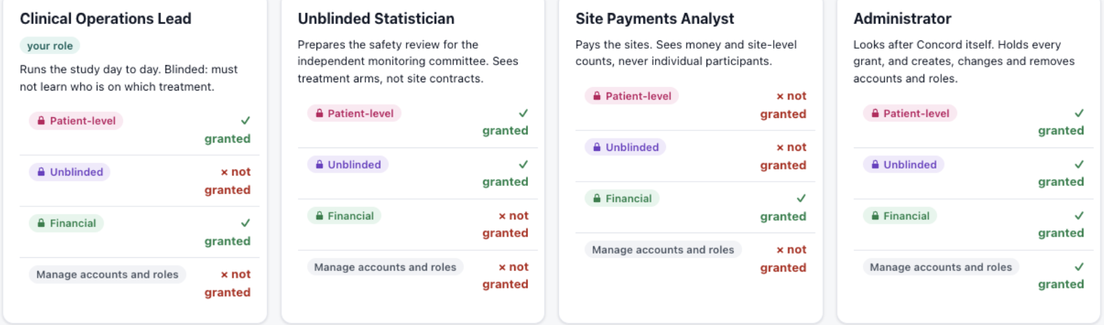
Continued
Login Authentication for RBAC
Query logic based on RBAC configurations
(Filtering, Gemini, SQL direct query)

Slide 9
Client
Ask queries in natural language
Write SQL for faster speed
Technologies:
Next.js
Tailwind CSS
TypeScript
View all messy or clean data
See how the data was harmonized
Role-based restricted access

Slide 10
Future Ponderence
File System & Medallion Access
File browser for raw feeds and Medallion layers (Bronze/Silver/Master/Gold)
Raw CSV/JSON and structured Parquet toggles
Zero-Downtime Data Lifecycle
Dynamic ingestion and archiving without server restarts
Live Gold table updates via Delta Lake transactions
Big Data & PySpark Scaling
Offload heavy crosswalk transformations to PySpark
Distributed processing for out-of-core, multi-terabyte datasets

Slide 11
Thank You

